Slide 1
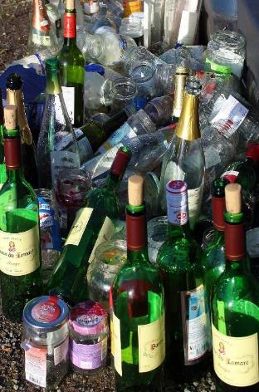
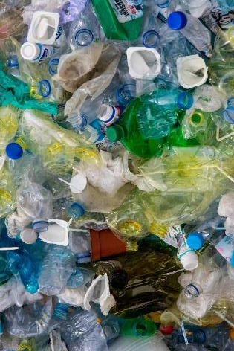
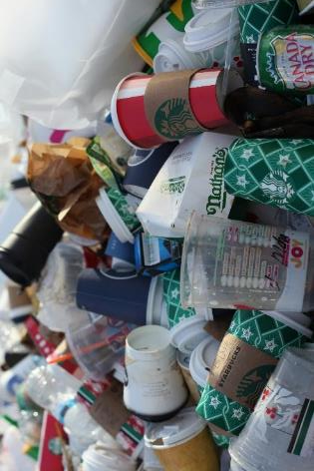
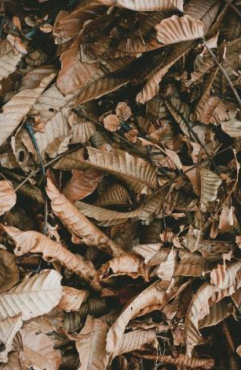
RECYCLE RIGHT
By Environmental Services

Slide 2
WHY RECYCLE?
Reduces the need for landfill
Reduces the need for raw materials which create air and water pollution
Helps to save energy
Reduces greenhouse gas emissions
Helps to tackle climate change

Slide 3
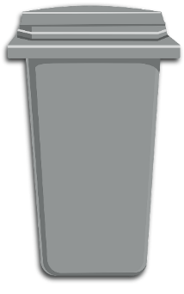
BINS IN THE DISTRICT
These are the wheelie bins we currently have collections for.
Garden
Recycling
General Waste
Glass

Slide 4
JAPAN In 1031 AD the first evidence of recycling was recorded. Documents were shredded and remade into new sheets of paper to be sold as new paper.
RECYCLING
… IT’S NOT NEW!
Can you guess which period these recycled items come from?
ANCIENT ROME One of the oldest examples of metal recycling stems from Ancient Rome. Romans melted down bronze coins to create statues.
ANCIENT GREECE In 4th Century BC, across Ancient Greece and Rome, there is evidence that glass was heavily reused and recycled.

Slide 5
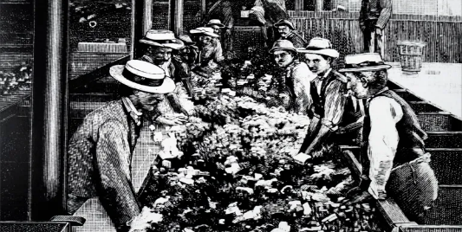
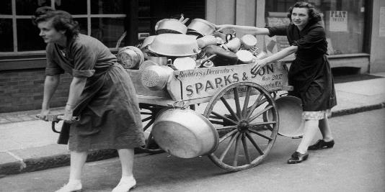
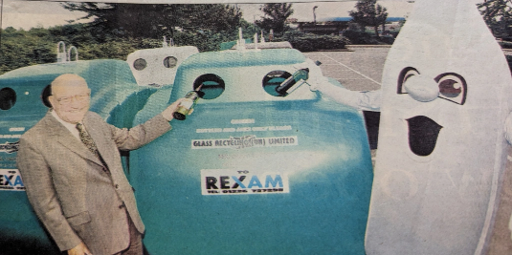
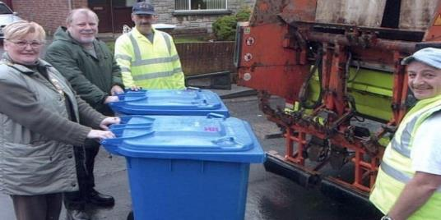
NEW YORK CITY - 1897
WARTIME - 1914 to 1935
UNITED STATES - 1970
First Materials Recovery Facility (MRF) was created. Metal, paper, fabric and more could be recovered and reused.
The public had to be smarter about what they threw away and how they separated waste. For example, cooking fat could be recycled into fuel for explosives.
A competition was held to find a new symbol for recycled paper. 23-year-old engineering student Gary Anderson entered this logo (Mobius Loop), earning himself $2000.
RECYCLING IN RECENT YEARS
BARNSLEY, SOUTH YORKSHIRE - 1977
ENGLAND - 2003
The first bottle bank was installed and kicked off the nationwide appearance of bottle banks.
Recycling legislation was introduced. It became law that local authorities in England provide households with collections.

Slide 6
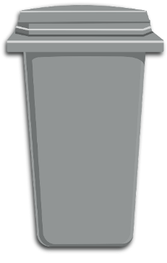
RECYCLING BIN
What items can be recycled in the silver bin?
Talk to your table about what you think can go in.

Slide 7
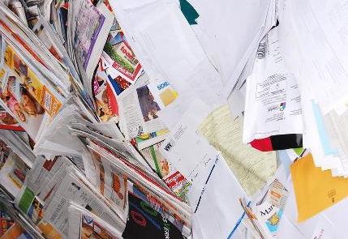
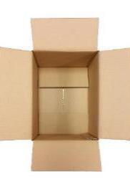
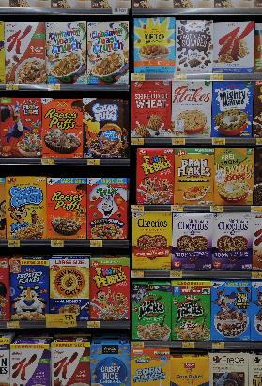
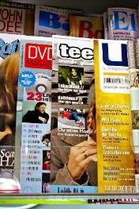
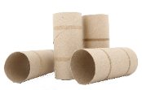
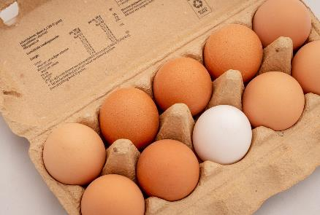
What can go in Recycling?
envelopes & junk mail
cardboard boxes & tubes
cereal boxes & cardboard packaging
newspapers
magazines &
catalogues
PAPER & CARDBOARD
egg boxes

Slide 8
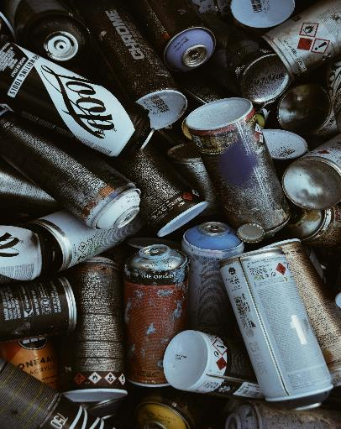
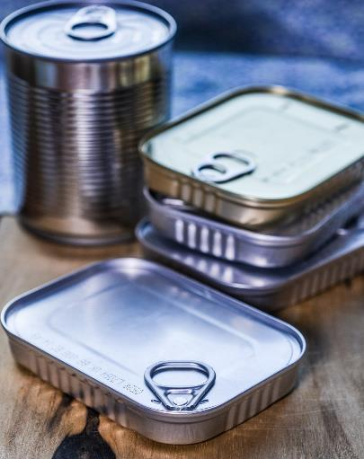
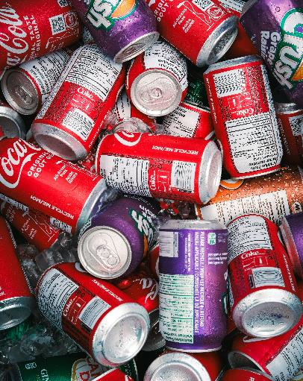
What can go in Recycling?
TINS & CANS
empty aerosol cans
food tins
drinks cans

Slide 9
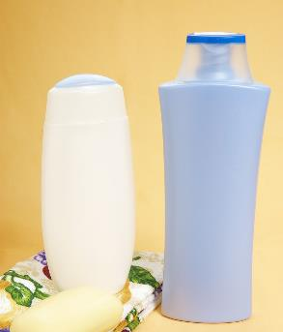
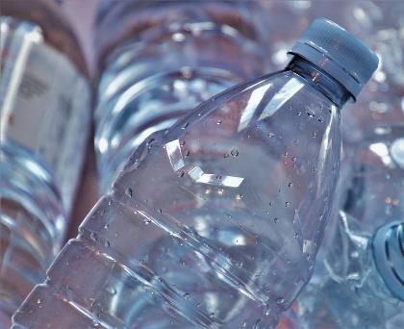
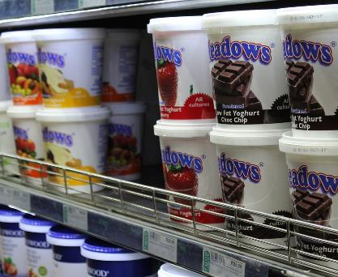
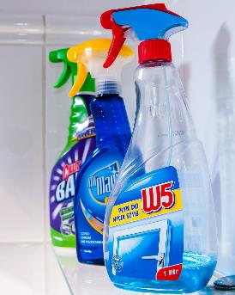
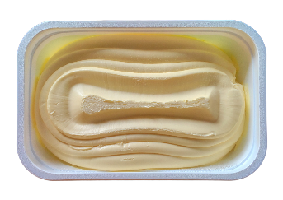
What can go in Recycling?
plastic shower gel & shampoo bottles (no dispensing pumps)
margarine tubs (no film, foil, or paper lids)
plastic drinks bottles (keep lids on)
yoghurt pots (no film or foil lids)
plastic cleaning bottles (no spray trigger nozzles or pumps)
All plastics, tins and cans must be empty, clean and dry before going in the bin.
Not all types of plastic lids are allowed so check carefully for what we can accept.
PLASTICS

Slide 10
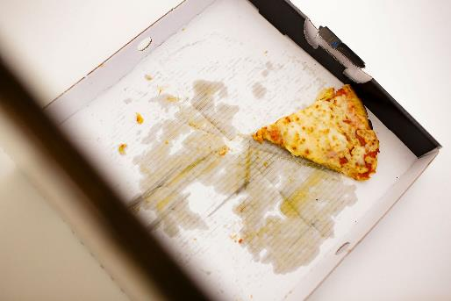
WHAT IS CONTAMINATION?
Contamination is when the wrong items are put into the wrong bin. There are two types of contamination:
when items with traces of food on it contaminate other items, meaning they can no longer be recycled e.g. used pizza boxes
when something which cannot be recycled is placed in your recycling bin
e.g. a plastic bag
Sometimes whole loads of recyclable waste must be rejected before they reach the recycling facility due to contamination.
The amount of contaminated recycling across Nottinghamshire is rising and we need everyone to help reduce this.
IF IN DOUBT, LEAVE IT OUT!

Slide 11
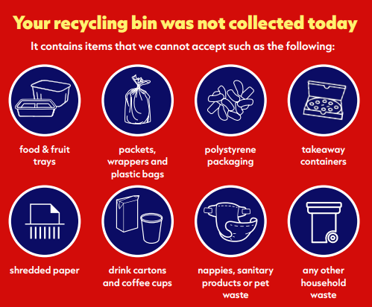
CONTAMINATED BINS
Bin operatives check recycling, glass and garden bins for contamination. Recycling bins are the most contaminated.
If your bin contains contamination, a sticker will be put on it. The adults at home will have to ring up to report the bin as missed due to contamination, and it will not be collected as recycling. It will be transported as general waste.
WHAT A WASTE!

Slide 12
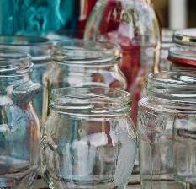
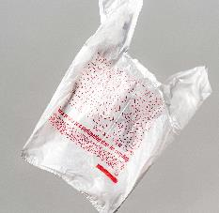
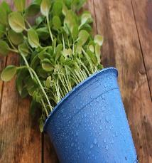
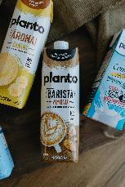
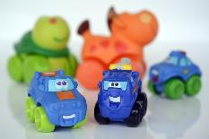
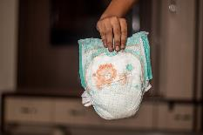
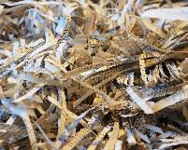
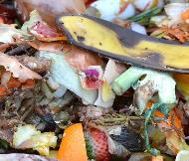
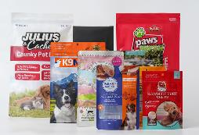
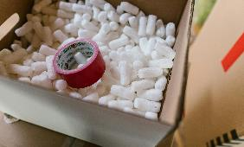
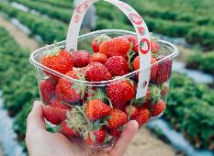
WHAT COULD CONTAMINATE?
These are the most common items that contaminate recycling bins. Don’t put these items in the recycling bin.
glass jars and bottles (recycle in your glass bin!)
plastic bags
plant pots
food & drinks cartons
Cartons are coated in plastic so cannot go in the silver bin. Recycle them at the Household Waste Recycling Centre! Toys, if in good, condition, could be donated to a charity shop.
toys
nappies
shredded paper
food waste
food pouches
polystyrene & bubble wrap
plastic food trays, punnets & containers

Slide 13
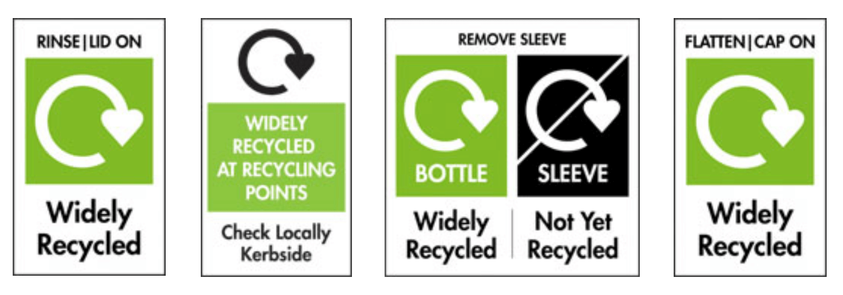
SYMBOLS! SYMBOLS EVERYWHERE!
Can all items with these symbols be put in our silver recycling bin?

Slide 14
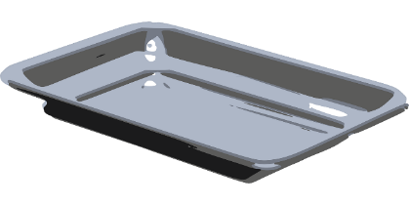
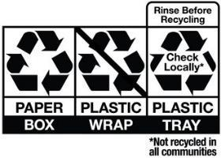
SYMBOLS! SYMBOLS EVERYWHERE!
No! Certain items – mainly plastics – cannot be recycled in our bins. For example, plastic food trays and fruit punnets are not accepted. The labels will often contain the recycling loop symbol but will tell you to check locally.

Slide 15
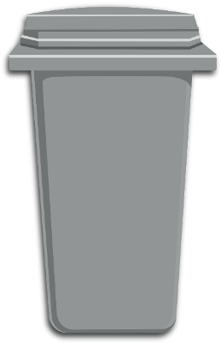
SAVE THE RECYCLING FROM
GENERAL WASTE
Recycling
Sort!
You will have 30 seconds to sort recyclables from non-recyclables!
Nom! Nom! Feed me waste!

Slide 16
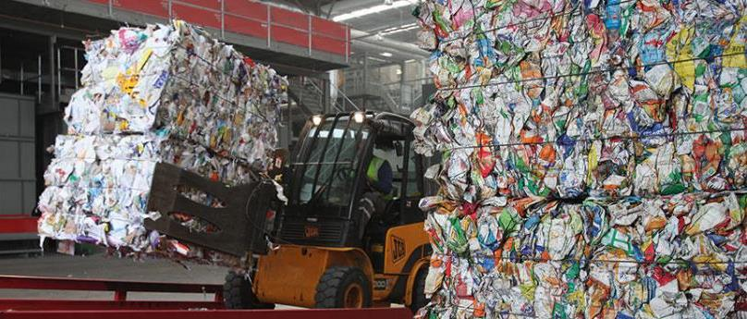
WHERE DOES OUR RECYCLING GO?
All the district’s recycling is transported to Veolia’s Materials Recovery Facility (MRF) in Mansfield.
Watch what happens inside using the video link below.
Mansfield Materials Recovery Facility (youtube.com)

Slide 17
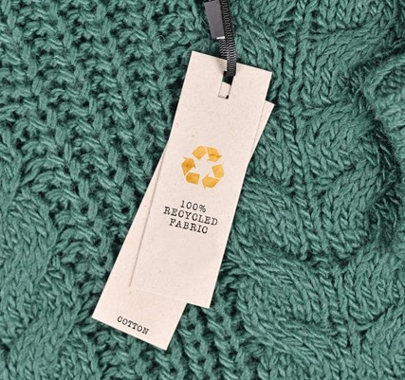
DO YOU OWN ITEMS MADE FROM RECYCLED MATERIALS?
Share with each other items you own which are made fully, or partially, from recycled materials.

Slide 18
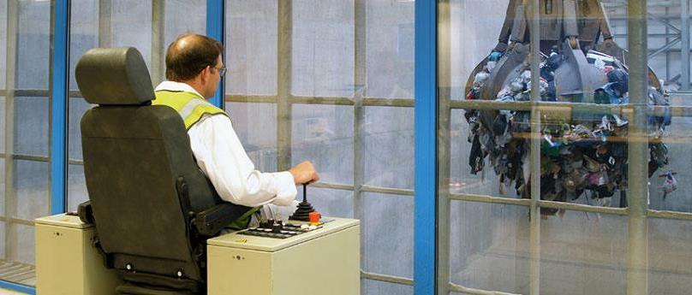
WHERE DOES OUR REFUSE GO?
All the district’s refuse is transported to Veolia’s Energy Recovery Facility (ERF) in Sheffield. Only 5% ends up in landfill!
Watch how your trash is turned into energy using the video link below.
Energy recovery from waste | Veolia (youtube.com)

Slide 19
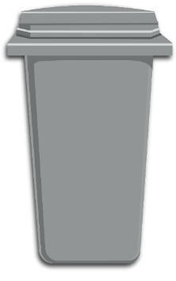
GLASS RECYCLING BIN
What glass items can be recycled in the teal-lidded bin?
Talk to your table about what you think can go in.

Slide 20
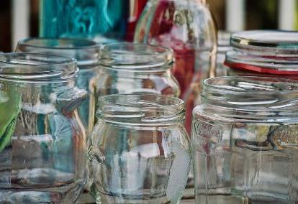
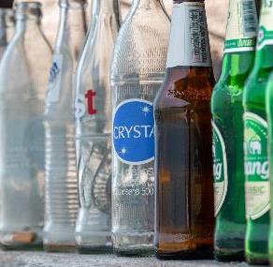
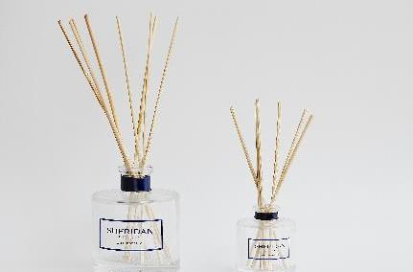
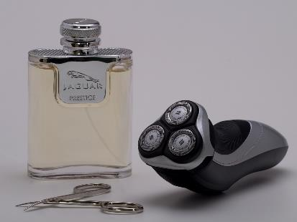
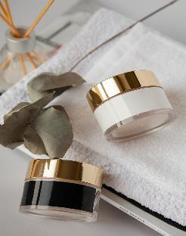
What can go in your GLASS bin?
glass food jars
glass drinks bottles
reed diffuser bottles
(no reeds)
perfume bottles
Your bin can take empty and clean glass bottles and jars of any colour. Lids need removing.
aftershave bottles
glass toiletry jars

Slide 21
WHAT COULD CONTAMINATE?
nail varnish bottles
vases
oven-proof glass
drinking glasses
Not all glass is recyclable as some have a higher melting point. Some light bulbs contain potentially dangerous substances such as mercury and should not be binned.
Don’t put these items in glass recycling.
The Household Waste Recycling Centre will recycle light bulbs – they should not go in any of your bins. Most opticians have a reading glasses recycling box too! Any items in good, working condition could be donated to a charity shop.
mirrors
light bulbs & tubes
panes of window glass
reading glasses
greenhouse glass

Slide 22
Glass
Sort!
GLASS INFINITY AND BEYOND
You will have 15 seconds to sort glass that can be recycled from glass that can’t be recycled!
Not all of you are recyclable!
I’m endlessly recyclable!
Making new products from me reduces CO2 emissions and energy use.

Slide 23
GARDEN WASTE RECYCLING BIN
Not everyone will have a garden waste recycling bin as they do need to be paid for each year. Garden waste can also be recycled at the Household Waste and Recycling Centre.
What items can be recycled in the brown bin?
Talk to your table about what you think can go in.

Slide 24
What can go in Garden waste?
plants & weeds
grass cuttings
hedge trimmings
leaves
The plant material will be recycled into compost through decomposition.
small branches & twigs
cut flowers

Slide 25
WHAT COULD CONTAMINATE?
These are the most common items that contaminate recycling bins. Don’t put these items in garden waste recycling.
food waste & vegetable peelings
plant pots & seed trays
invasive plants (such as Japanese knotweed)
Treated wood (such as fence panels/ chairs) can be recycled at the Recycling Centre.
animal bedding (such as straw, hay or cat litter)
treated wood (any wood that has been processed)
bin liners

Slide 26
FOR EVERYTHING ELSE…
The Household Waste Recycling Centres will take separated recyclables to reduce the amount going into refuse.
The General Waste bin will take smaller items that can’t be recycled.

Slide 27
Recycling
Relay!
Relay your recycling knowledge!
Get ready to sort all the recyclables!
They need saving from the general waste bin!

Slide 28
ECONOMIC REASONS TO RECYCLE
1 JOB
10 JOBS
10,000 tons of waste incinerated or sent to landfill creates…
10,000 tons of recycling processed at recycling facilities creates…

Slide 29
Fancy a TOUR of the mrf?
Tours of the Veolia Nottinghamshire Materials Recovery Facility in Mansfield can be arranged for classes throughout the year with Veolia’s Recycling and Education Officer.
If your school is within the Nottinghamshire County Council area transport reimbursement might be available. Get in touch below to find out more.
Alternatively, the Education, communication and Outreach Officer travels across Nottinghamshire to give talks to groups in the county who would like to learn more about recycling.
To arrange a tour or talk contact Veolia on Tel: 0203 567 4391
Email: nottsenquiries@veolia.co.uk

Slide 30
THANK YOU FOR YOUR TIME
For further information in relation to this presentation, please get in touch:
Environmental.Services@newark-sherwooddc.gov.uk

